Slide 1

Other Highway Data
Reverse Data Pitch
May 27, 2015

Slide 2

Data Programs Include
Bridges
Traffic Volume Trends
Highway Statistics
Traveler demographics
Freight and passenger models
Research

Slide 3
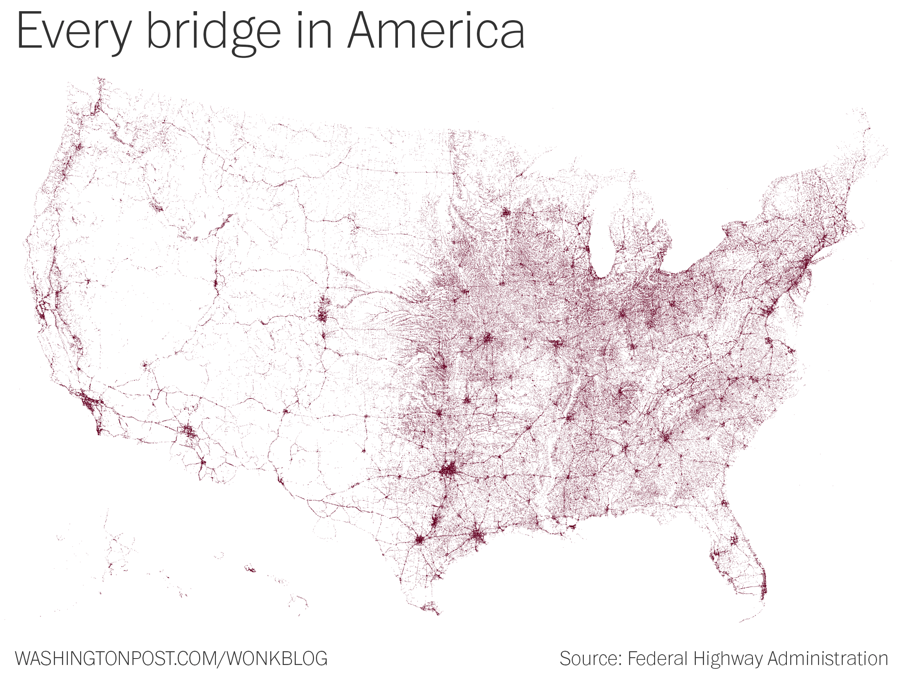
National Bridge Inventory
http://www.fhwa.dot.gov/bridge/nbi/ascii.cfm
1992 – 2014 ASCII files
Provides:
Inventory
Attributes
Condition
Notes:
Each bridge updated every 2 years
Spatial accuracy varies
Not to be used for Heavy Vehicle routing

Slide 4
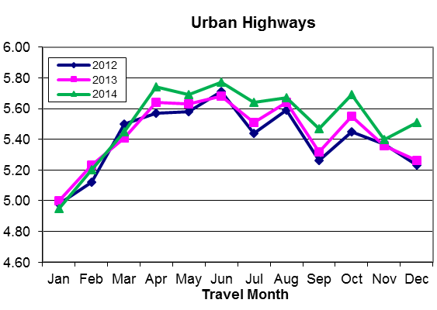
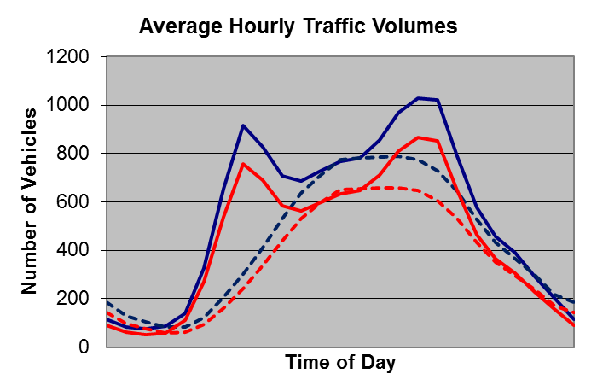
Traffic Volume Trends
http://www.fhwa.dot.gov/policyinformation/travel_monitoring/tvt.cfm
Dates back to April 1942
Monthly data from 1970 to present
Coming soon: underlying hourly volume data, with some vehicle class and weight data.

Slide 5
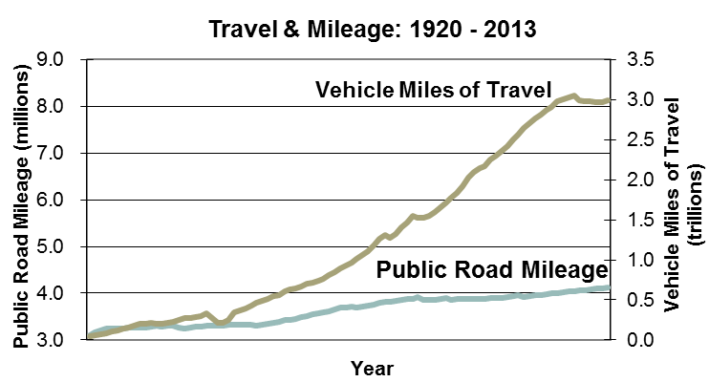
Highway Statistics
http://www.fhwa.dot.gov/policyinformation/statistics.cfm
Dates back to 1945
Tabular data from 1992 to present
Time series
Charts
National, State, and Local level data
Topic areas include:
Highway infrastructure extent, use, condition, and performance
Travel
Licensed drivers
Motor vehicle registration
Motor fuel
State and local finance

Slide 6
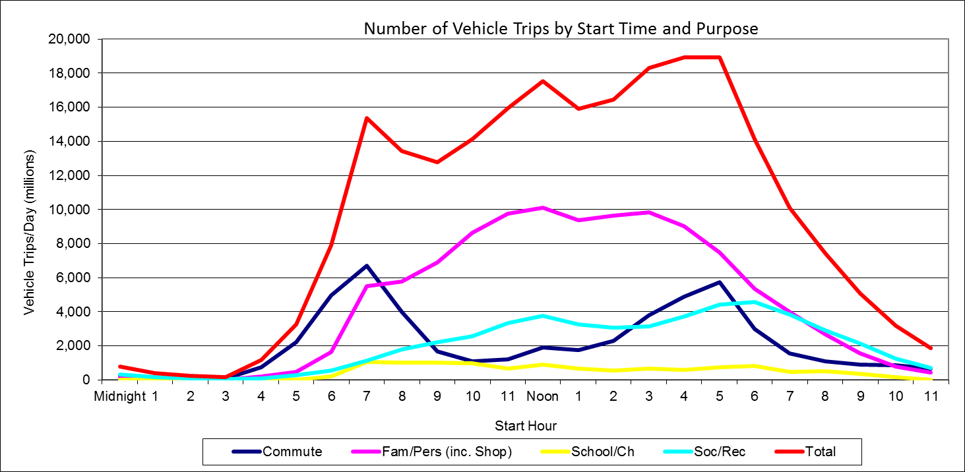
National Household Travel Survey
http://nhts.ornl.gov/introduction.shtml
National survey of travel and transportation patters in the U.S.
Survey years: 1969, 1977, 1983, 1990, 1995, 2009, 2016
Traveler demographics
Purpose of the trip (work, shopping, social, etc.)
Means of transportation (car, walk, bus, subway, etc.)
Travel time of trip
Time of day/ day of week

Slide 7
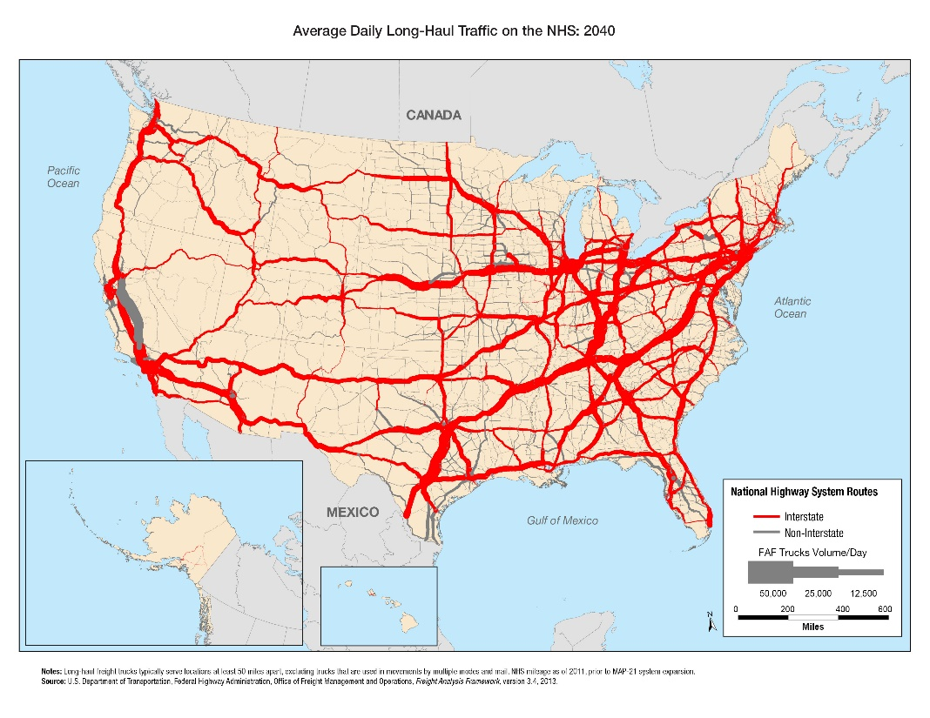
Freight & Passenger Models
Freight Analysis Framework
http://ops.fhwa.dot.gov/Freight/freight_analysis/faf/index.htm
Estimates for tonnage, value, and domestic ton-miles
By region of origin and destination, commodity type, and mode
2007 base year, 1997 and 2040
Flows by truck assigned to the highway network for 2007 and 2040
Passenger Travel Model
Coming soon
Multi-modal
County to county O-D matrices will published later this year

Slide 8
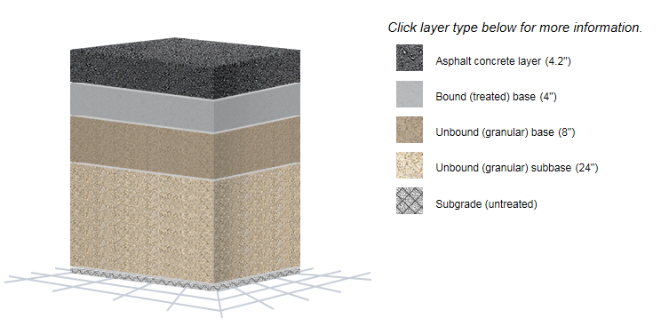
Long Term Pavement Performance
Long Term Pavement Performance
http://www.fhwa.dot.gov/research/tfhrc/programs/infrastructure/pavements/ltpp/
http://www.infopave.com/
Since 1991
Collects general and specific pavement data from over 2,500 test sections nationwide
Types of data include:
Inventory
Maintenance
Monitoring
Rehabilitation
Materials testing
Traffic
Climate

Slide 9
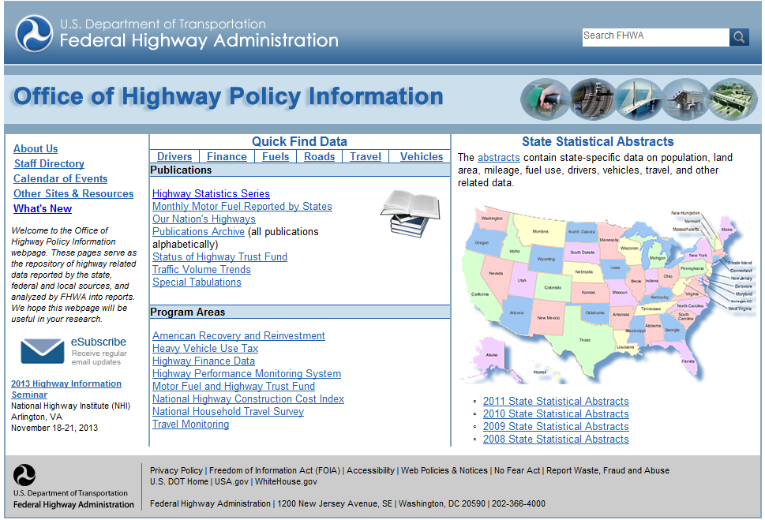
Office Website http://www.fhwa.dot.gov/policyinformation/

Slide 10
Thank You!

